Slide 1
Selenium WebDriver Training
Target Locators
Window Handling

Slide 2
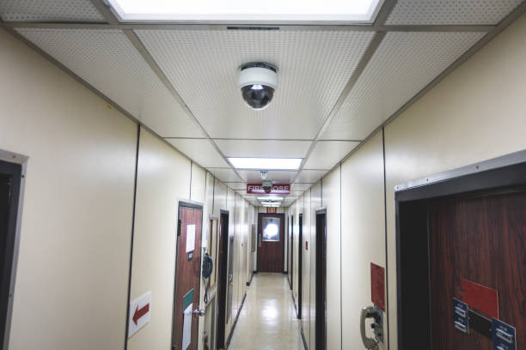
Window handle-Unique address
Selenium WebDriver Training
Each house holds unique address
Target Locators
Window Handling

Slide 3
The Golden Circle
What
What is WindowHandle?
Holds unique address of browser window /tab
Why
Why do we need to handle it?
To switches between the multiple windows
How to handle it?
How
Transfer the driver control to child window

Slide 4
More about window handling..
-to handle multiple windows scenarios in selenium ,window handler is used .
-Window handles holds the address of the each opened browser window/tab
-Window handles are unique for each window/tab and
returns the address of each window as alphanumeric characters. Ex:CDwindow-BD4E4EE55706D7CB7EA652049B03B152
CDwindow-B795D2AA615D39AFC20F6D2D904412DF

Slide 5
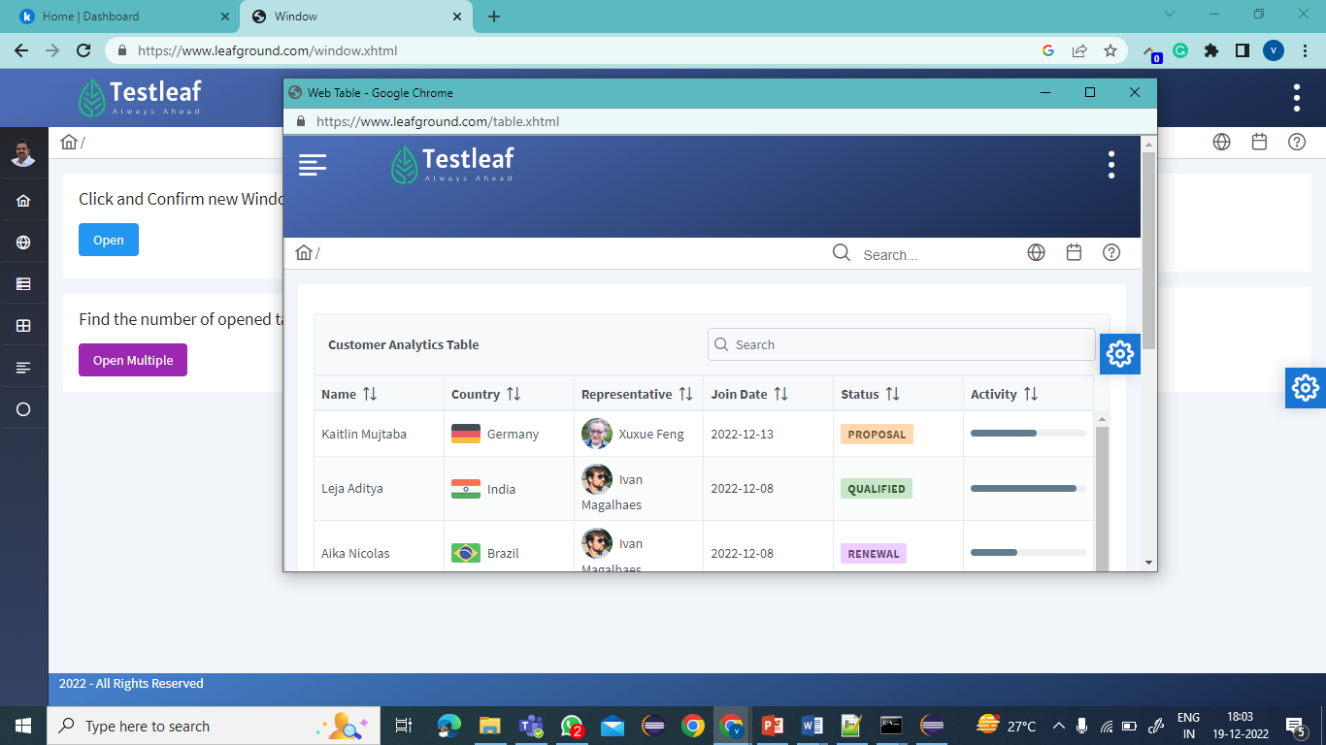
Window Handle
To get the address of opened windows, the selenium
provides two methods.
getWindowHandle() -> to get the current window id
as a string
getWindowHandles ()->returns the set of all the opened windows /tab as Set<string>

Slide 6
How to Handle it ?
To handle windows
Transfer the driver focus to requied window
syntax:
driver.switchTo().Window(Windowname);
Note: Return type of it is webdriver interface and the implementation class is RemoteWebDriver
Primitive

Slide 7
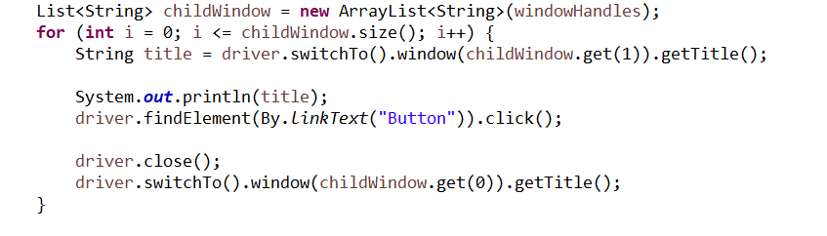
Steps to handle multiple windows
Step:1
Get the window Handles Set<String> windowHandles= driver. getWindowHandles();
Step:2
Convert the set to list
Step:3
Use SwitchTo method to switch between the windows using the Windowhandle

Slide 8
Classroom
1. Load https://www.irctc.co.in/
2. Click on FLIGHTS link
3. Get the title (filghts window -AirTicket )
4. Close the First tab(Train ticket booking) alone

Slide 9


Summary
Window handle-> hold the unique address of the web element
To be handled by switching the driver control into the webElement
getWindowHandle() ->hold the address of the current webpage
getWindowHandles()->holds the address of all opened browsers

Slide 10
Mind Map
driver.quit();
closes the all opened browsers
Holds the address of multiple windows/tab
Holds unique address of the window
To navigate to next window
driver.SwitchTo().
window(winHandle)
driver.getWindowHandles()
Window Handle
driver.getWindowHandle()
driver.close();
closes the current active window
Holds the address of current active window/tab
NoSuchWindowEception

